Slide 1
Introduction to Algorithms
Computer science department,
Faculty of computer and information sciences,
Ain shams university.

Slide 2
Algorithm Design Techniques -3
Greedy Algorithms

Slide 3
Huffman Codes

Slide 4
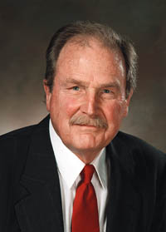
David Huffman’s idea
A data compression technique
A term paper at MIT, 1952
While he was a Ph.D. student at MIT, Huffman published "A Method for the Construction of Minimum-Redundancy Codes"
Build the tree (code) bottom-up in a greedy fashion

Slide 5
Data Compression
Suppose we have 1,000,000,000 (1G) character data file that we wish to include in an email.
Suppose file only contains 26 letters {a,…,z}.
Suppose each letter α in {a,…,z} occurs with frequency f_{α}.
Suppose we encode each letter by a binary code
If we use a fixed length code, we need 5 bits for each character
The resulting message length is 5( f_{a}+ f_{b} + … + f_{z})

Slide 6
Huffman Coding
Huffman codes can be used to compress information
Like WinZip – although WinZip doesn’t use the Huffman algorithm
JPEGs do use Huffman as part of their compression process
The basic idea is that instead of storing each character in a file as an 8-bit ASCII value, we will instead store the more frequently occurring characters using fewer bits and less frequently occurring characters using more bits
On average this should decrease the filesize (usually ½)

Slide 7
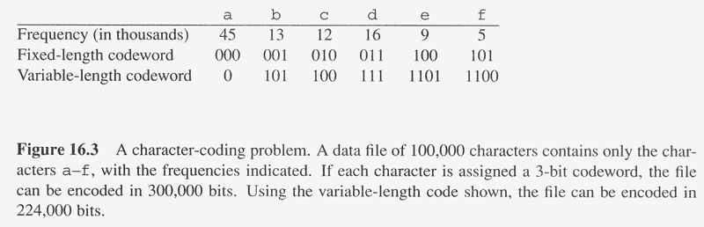
Data Compression: Example
variable length encoding can save 20% to 90% space
Huffman’s greedy algorithm uses a table of the frequencies of occurrence of each character to build up an optimal way of representing each character as a binary string
C: Alphabet

Slide 8
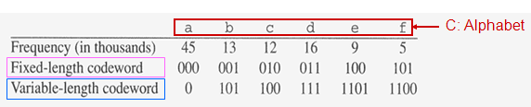
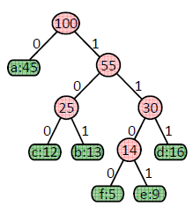
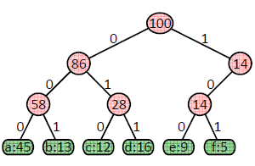


Prefix Codes

Slide 9
An example

Slide 10
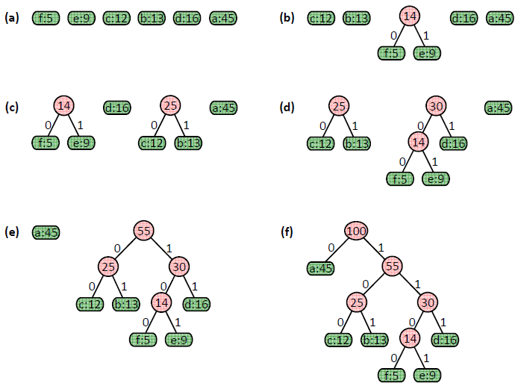

Slide 11
Huffman Coding
As an example, lets take the string:
“duke blue devils”
We first to a frequency count of the characters:
e:3, d:2, u:2, l:2, space:2, k:1, b:1, v:1, i:1, s:1
Next we use a Greedy algorithm to build up a Huffman Tree
We start with nodes for each character
e,3
d,2
u,2
l,2
sp,2
k,1
b,1
v,1
i,1
s,1

Slide 12
Huffman Coding
We then pick the nodes with the smallest frequency and combine them together to form a new node
The selection of these nodes is the Greedy part
The two selected nodes are removed from the set, but replace by the combined node
This continues until we have only 1 node left in the set

Slide 13
Huffman Coding
e,3
d,2
u,2
l,2
sp,2
k,1
b,1
v,1
i,1
s,1

Slide 14
Huffman Coding
e,3
d,2
u,2
l,2
sp,2
k,1
b,1
v,1
2
i,1
s,1

Slide 15
Huffman Coding
e,3
d,2
u,2
l,2
sp,2
k,1
2
2
b,1
v,1
i,1
s,1

Slide 16
Huffman Coding
e,3
d,2
u,2
l,2
sp,2
3
2
k,1
2
i,1
s,1
b,1
v,1

Slide 17
Huffman Coding
e,3
d,2
u,2
4
3
2
l,2
sp,2
k,1
2
i,1
s,1
b,1
v,1

Slide 18
Huffman Coding
e,3
4
4
3
2
d,2
u,2
l,2
sp,2
k,1
2
i,1
s,1
b,1
v,1

Slide 19
Huffman Coding
e,3
4
4
5
d,2
u,2
l,2
sp,2
2
3
i,1
s,1
k,1
2
b,1
v,1

Slide 20
Huffman Coding
7
4
5
e,3
4
l,2
sp,2
2
3
d,2
u,2
i,1
s,1
k,1
2
b,1
v,1

Slide 21
Huffman Coding
7
9
e,3
4
4
5
d,2
u,2
l,2
sp,2
2
3
i,1
s,1
k,1
2
b,1
v,1

Slide 22
Huffman Coding
16
7
9
e,3
4
4
5
d,2
u,2
l,2
sp,2
2
3
i,1
s,1
k,1
2
b,1
v,1

Slide 23
Huffman Coding
Now we assign codes to the tree by placing a 0 on every left branch and a 1 on every right branch
A traversal of the tree from root to leaf give the Huffman code for that particular leaf character
Note that no code is the prefix of another code

Slide 24
Huffman Coding
e | 00
d | 010
u | 011
l | 100
sp | 101
i | 1100
s | 1101
k | 1110
b | 11110
v | 11111
16
0
1
7
9
0
1
0
1
e,3
4
4
5
0
1
0
1
0
1
d,2
u,2
l,2
sp,2
2
3
0
1
0
1
i,1
s,1
k,1
2
0
1
b,1
v,1

Slide 25
Huffman Coding
These codes are then used to encode the string
Thus, “duke blue devils” turns into:
010 011 1110 00 101 11110 100 011 00 101 010 00 11111 1100 100 1101
010 011 1110 00 101 11110 100 011 00 101 010 00 11111 1100 100 1101
When grouped into 8-bit bytes:
01001111 10001011 11101000 11001010 10001111 11100100 1101xxxx
Thus it takes 7 bytes of space compared to 16 characters * 1 byte/char = 16 bytes uncompressed

Slide 26
Huffman Coding
Uncompressing works by reading in the file bit by bit
Start at the root of the tree
If a 0 is read, head left
If a 1 is read, head right
When a leaf is reached decode that character and start over again at the root of the tree
Thus, we need to save Huffman table information as a header in the compressed file
Doesn’t add a significant amount of size to the file for large files (which are the ones you want to compress anyway)
Or we could use a fixed universal set of codes/freqencies

Slide 27
Huffman‘s Algorithm

Slide 28
Constructing A Huffman Code
C is a set of n characters
Each character c ∈ C is an object with a frequency, denoted by f[c]
The algorithm builds the tree T in a bottom-up manner
Begin with |C| leaves and perform a sequence of |C|-1 merging
A min-priority queue Q, keyed on f, is used to identify the two least-frequent objects to merge together
The result of the merger of two objects is a new object whose frequency is the sum of the frequencies of the two objects that were merged

Slide 29

Huffman Codes
A very effective technique for compressing data.
A prefix code in which no codeword is also a prefix of some other codeword.
An optimal prefix binary code.
Huffman coding problem
Input: A alphabet C = {c1, c2,..., cn} of n characters.
Each character ci has a frequency fi >0.
Output: A prefix binary code for C with minimum cost.
The code is represented by a full binary tree.
The leaves of the code tree represent the given characters.
dT(c) is the length of the codeword for character c.
The number of bits required to encode a file is

Slide 30
Huffman’s Algorithm
Algorithm HuffmanEncoding(X)
Input string X of size n
Output optimal encoding tree for X
C ← distinctCharacters(X)
computeFrequencies(C, X)
Q ← new empty heap
for all c ∈ C
T ← new single-node tree storing c
Q.insert(getFrequency(c), T)
while Q.size() > 1
f₁ ← Q.minKey()
T₁ ← Q.removeMin()
f₂ ← Q.minKey()
T₂ ← Q.removeMin()
T ← join(T₁, T₂)
Q.insert(f₁ + f₂, T)
return Q.removeMin()
Given a string X, Huffman’s algorithm construct a prefix code the minimizes the size of the encoding of X
It runs in time O(n + C log C), where n is the size of X and C is the number of distinct characters of X
A heap-based priority queue is used as an auxiliary structure

Slide 31
Thank You

